Slide 1
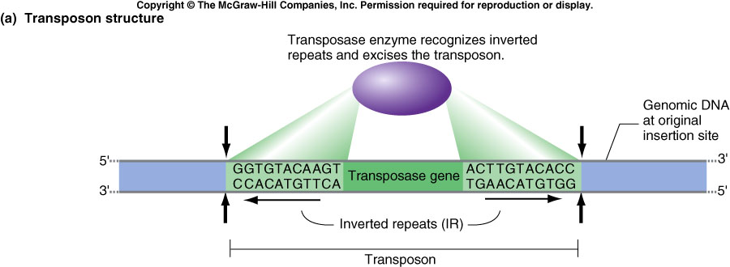
Transposable elements
Genes represent only a small portion of the genome in eukaryotes
● Repeat elements can represent from 25% to over 80% of the genome (e.g. wheat)
Retrotransposons
transposons
Classification from Wicker et al (2007). A unified classification system for eukaryotic transposable elements.
Nat Rev Genet, 8, 973-982.
Notes:
Genes represent only a little part of the genome
The aim of the annotation is also to predict the structure of the others component of the genome and notably the transposable elements.
Here we can see a table of the TE classification. This classification has been suggested and published by wicker et al in 2007.
In fact, TE are like usually classified in class, order, superfamily and family.
And Like there was no clear rules for choosing transposable elements names, wicker et al suggested to use a code to maintain the traceability and origine of TE.
For example, the name RLC_Rhum_Sh53A11
R means Retrotransposon class,
L means Order LTR
C means Copia superfamily
Rhum is the name of the element
And Sh53A11 is the Saccharum hybrid BAC clone from where the TE was annotated.
If the sequence is published, the accession number can be attributed.
1

Slide 2
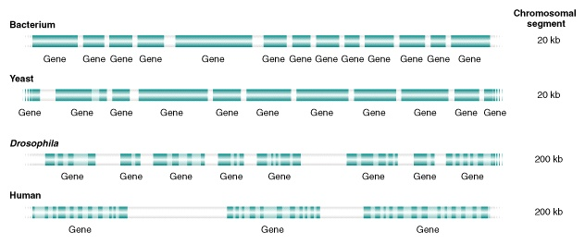
TE vs Genes
22% ET
45% ET

Slide 3
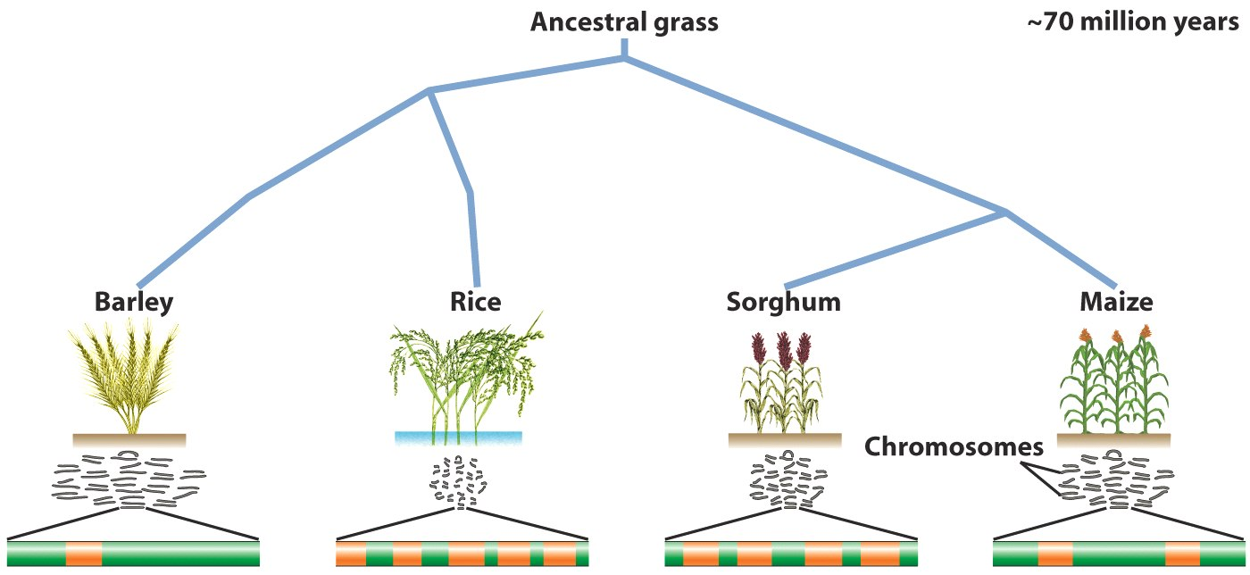
TE vs Genes
~50 myr
~10 myr
4800 Mb
430 Mb
750 Mb
2500 Mb
Genes
TEs
Notes:
3

Slide 4
Different classes of transposable elements
In plants, the most abundant repeated elements (in terms of % genome coverage) are the LTR retrotransposons
Retrotransposons
with LTR
Notes:
4

Slide 5
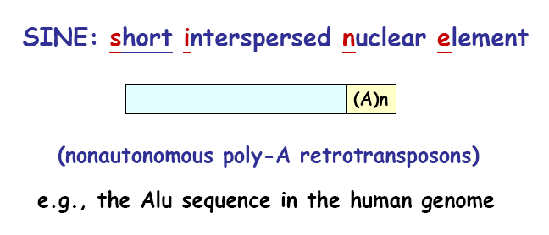
Different classes of transposable elements
Retrotransposons
without LTR
Notes:
5

Slide 6
Different classes of transposable elements
Transposon

Slide 7
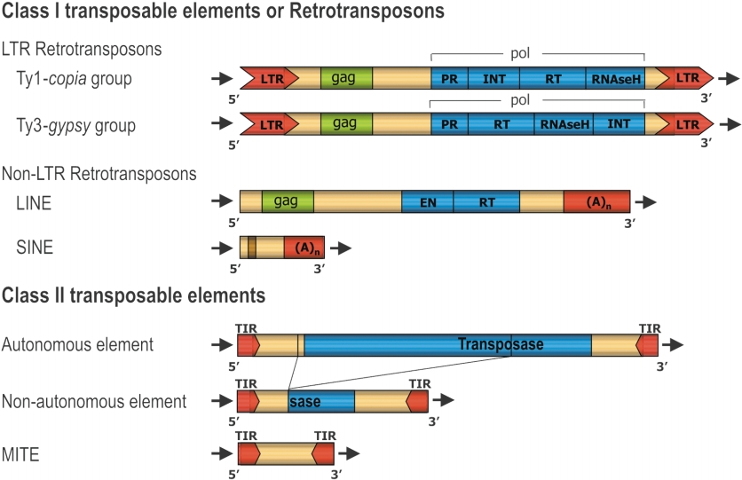
TE Classification
Casacuberta and Santiago, Gene 2003

Slide 8
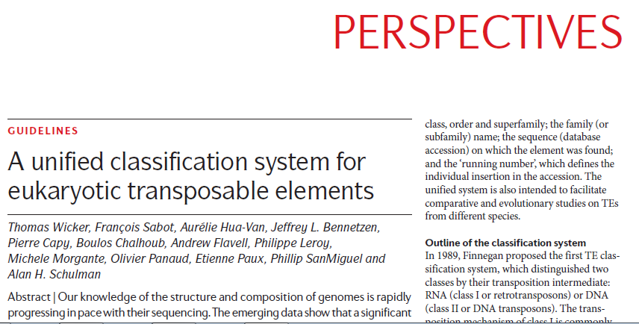
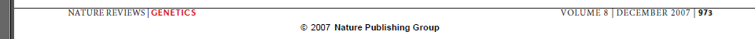
TE Classification

Slide 9
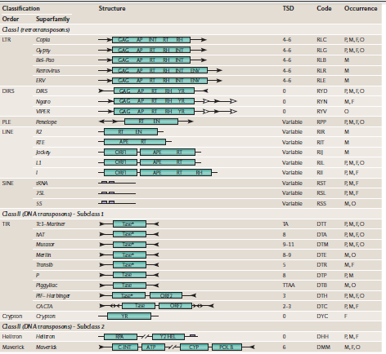
TE classification

Slide 10
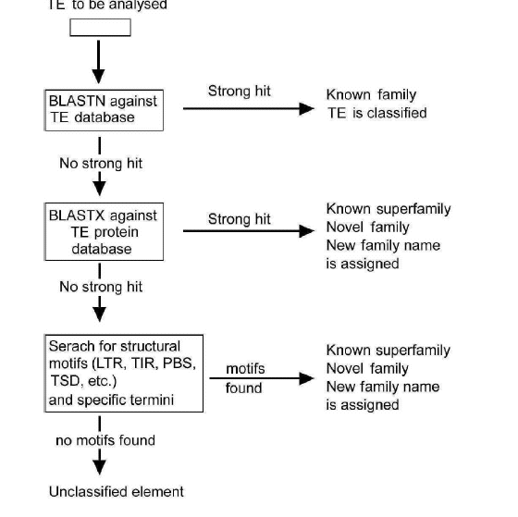
Detection of TE

Slide 11
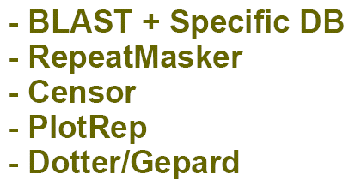
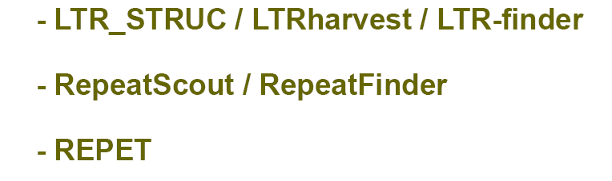
Tools for structural annotation of transposable elements
Annotation using homology
Repeat prediction

Slide 12
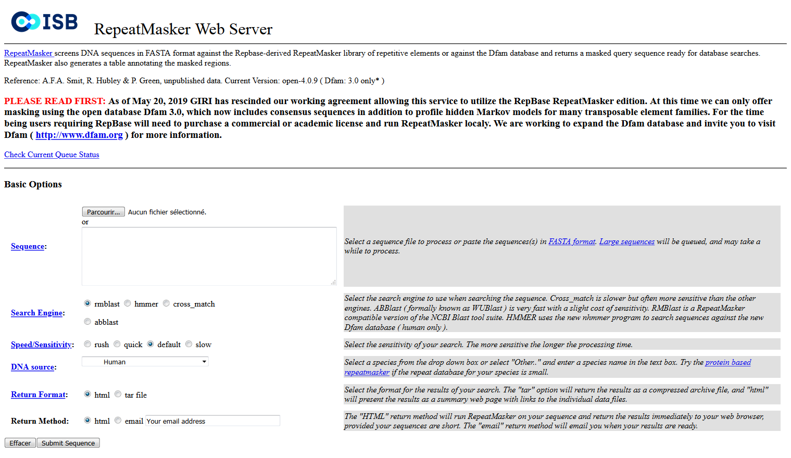
Hide repeated sequences
Repeat elements can be filtered out before gene annotation
➢ Repeat masker is the most widely used tool for masking repeats
http://www.repeatmasker.org/cgi-bin/WEBRepeatMasker
Notes:
12
Before to annotate the genes, we need generally to filtering out the repeats because the presence of repeats make the gene modelling more difficult.
There are severals raisons,
TEs may look like protein encoding genes (transposase and remains)
TEs perturb the gene struture prediction, e.g. If a TE is inserting in a intron of a gene, that will make a long insertion, and the gene model will be cut in many parts, so the prediction will not be good)
Repeat masker is the tool the mostly used to mask repeats.
A web server of repeatmasker is available at this adress.
12

Slide 13
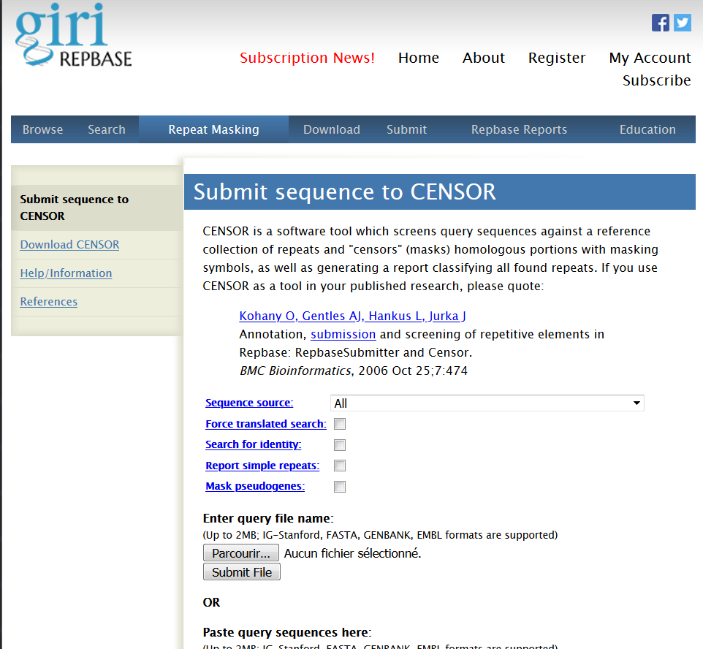
Hide repeated sequences
https://www.girinst.org/censor/
Notes:
13
Before to annotate the genes, we need generally to filtering out the repeats because the presence of repeats make the gene modelling more difficult.
There are severals raisons,
TEs may look like protein encoding genes (transposase and remains)
TEs perturb the gene struture prediction, e.g. If a TE is inserting in a intron of a gene, that will make a long insertion, and the gene model will be cut in many parts, so the prediction will not be good)
Repeat masker is the tool the mostly used to mask repeats.
A web server of repeatmasker is available at this adress.
13

Slide 14
